Slide 1

MMDE 11-150 Web Design
Lecture 1
→ Subject Overview
→ The Internet & The World Wide Web
Semester 102
Dr. James Birt

Slide 2

Introduction – About Me
Dr. James Birt (Ph.D.)
Assistant Professor of Multimedia & Games
8+ yrs teaching experience
5+ yrs industry experience (SE, PM & QA)
Research Interests: AI, Games, Visualisation, Software Engineering, Multimedia & Education
Hobbies: Computer Games (25+ yrs), Poker
Email: jbirt@bond.edu.au
Phone Ext: 52697
Consult hours: See timetable (room 4.45)

Slide 3

Introduction – About Course
Fundamental & theoretical concepts used in universal website design
Develop practical software skills required to design, implement & manage web sites consisting of multiple web pages
Students will create websites containing a wide range of content using Adobe Fireworks, Adobe Dreamweaver & Adobe Flash
Topics covered include:
Globally recognised design principles and theory
HTML and Cascading Style Sheets
Internet & Web concepts
Web 2.0
Planning & design documentation
Web site structure & Accessibility
Colour management & Typography
Image file formats & Professional issues

Slide 4
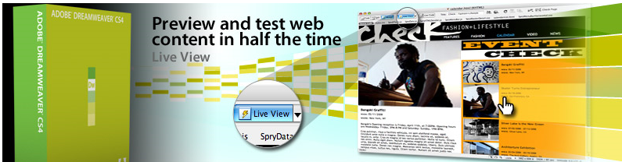
MMDE 11-150 - Goals
On completion of this subject students should have a solid comprehension of essential web design principles, a theoretical understanding of established considerations and standards and also understand the relevance of these to successful Website Design
Students should be competent using Adobe Dreamweaver software to design, create or manipulate web pages
Develop fundamental skills in the use of Adobe Fireworks software to design, create or manipulate digital images
Understand the relevance and use of Adobe Flash software to design, create or manipulate animated movie files
Understand professional issues within the WWW environment
Understand the technical considerations and requirements for successful website designs

Slide 5
iLearn
Bond University iLearn subject code is: MMDE11-150
http://iLearn.bond.edu.au
Required textbook
‘Adobe Dreamweaver CS4 Digital Classroom’
Available from the Bond Uni Bookshop
All Fireworks and Flash tutorials available online each week as needed.

Slide 6
Teaching Methods
There is no specific text book to cover the theory part of this course. This information is delivered through the weekly lecture slides.
All Lecture slides and other information is made available online.
Extra information may be handed out in the lectures and is examinable – it is also expected that you will take notes.
Attendance is recorded during lectures and tutorials and is used as an assessment item and for managing @RISK students.

Slide 7
Teaching Methods
Lecturer: James Birt
Room 4_45, Level 4, Humanities Building 1a
Tutors: * James Birt * Tony Ravenscroft
Consultation hours on office door
This subject is 10 Credit points=10 hrs per wk!
2 hour lecture
3 hour tutorial
5 hour STUDY!!!

Slide 8
Topics Covered
The Internet and Web Concepts
Basic HTML
Cascading Style Sheets (CSS)
Website Planning and Development
Web Site Design Principles
Page and Content, Colour, Type Graphics
File Formats
Flash Movies
Multimedia on the Web
E-Life and working as a Web Designer

Slide 9
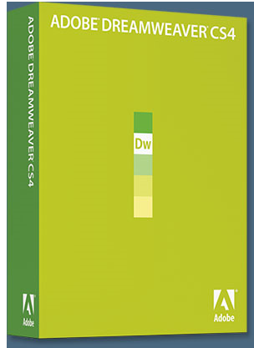


Software
Industry standard software, Adobe Dreamweaver, Adobe Fireworks and Adobe Flash.

Slide 10
What is Dreamweaver?
Adobe software for aiding in the development and management of objects & code.
Offers support for web sites, mobile phone content development & complex programming /script options.
Does not CREATE images or content from scratch → Integrates with Photoshop , Illustrator & Fireworks.
Has everything you need for complete site management, including a built in file transfer protocol ( FTP) between a server and your local machine.
It will even check cross-browser compatibility.

Slide 11
Assessment
Task | Weight [%] | Due Date
Assignment 1: * Create a small (5 page) web site in Adobe Dreamweaver * Images should be edited in Adobe Fireworks/Photoshop * Submission: upload the site to a remote server with project planning documentation, preliminary drawings and log book. | 15 | Week 6 Friday 12 pm
Five online quizzes relating to topics discussed in lectures and extra reading as supplied. | 10 | Weeks 3, 5, 7, 9, 11
Assignment 2: * Using Adobe Dreamweaver, Fireworks & Flash in combination, create and upload a technically sophisticated web site (12 pages), incorporating the design rules and WWW guidelines covered in this subject. * Submit with project planning documentation, preliminary drawings and log book. | 25 | Week 12 Friday 12 pm
Final Theory Exam, 2 hours, multiple choice, short and long answer questions covering all lecture material for the full semester . Closed Book . Paper translation dictionaries only allowed. Electronic dictionaries not allowed. | 35 | Week 14 - TBA
Attendance at lectures and tutorials and demonstrated completion of all tutorial tasks to be completed during tutorial time. | 15 | Weekly lab & lectures

Slide 12
BUT BEFORE WE LOOK at how websites work we should understand The Evolution of the Internet

Slide 13
Outline
History of the Internet
Evolution of the Internet
Network Overview
TCP/IP
LANs/MANs/WANs/Internet
World Wide Web (WWW)
Standards
Impacts and Future Trends

Slide 14
History of the Internet
The Internet began as a military research project in the late 1960’s.
The US Defence Dept. created a network, called ARPANET, that covered a large geographic area and that would continue to function even if part of the network failed.
The improved high-speed network that developed from this technology became the Internet.
Readings: Leiner, B (2009). A Brief History of the Internet. Journal of Computer communication review, 39(5), 22.

Slide 15
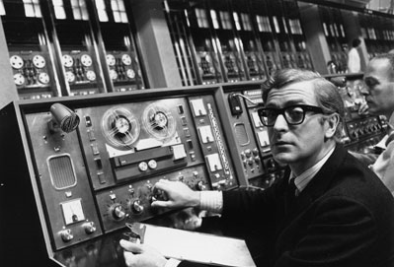
History of the Internet
In the 1980’s most of the people accessing the Internet were scientist and researchers.
In the early 1990’s, companies began to offer Internet access to home users and the Internet eventually grew to include organisations and individual around the world.

Slide 16
History of the Internet
In 1989 there was over 100,000 hosts on the Internet.
The ban on commercial use was lifted in 1991 and by the end of 1992 there were over a million hosts connected
Today??
http://www.internetworldstats.com/stats.htm

Slide 17
WORLD INTERNET USAGE AND POPULATION STATISTICS
World Regions | Population ( 2009 Est.) | Internet Users Dec. 31, 2000 | Internet Users Latest Data | Penetration (% Population) | Growth 2000-2009 | Users % of Table
Africa | 991,002,342 | 4,514,400 | 86,217,900 | 8.7 % | 1,809.8 % | 4.8 %
Asia | 3,808,070,503 | 114,304,000 | 764,435,900 | 20.1 % | 568.8 % | 42.4 %
Europe | 803,850,858 | 105,096,093 | 425,773,571 | 53.0 % | 305.1 % | 23.6 %
Middle East | 202,687,005 | 3,284,800 | 58,309,546 | 28.8 % | 1,675.1 % | 3.2 %
North America | 340,831,831 | 108,096,800 | 259,561,000 | 76.2 % | 140.1 % | 14.4 %
Latin America/Caribbean | 586,662,468 | 18,068,919 | 186,922,050 | 31.9 % | 934.5 % | 10.4 %
Oceania / Australia | 34,700,201 | 7,620,480 | 21,110,490 | 60.8 % | 177.0 % | 1.2 %
WORLD TOTAL | 6,767,805,208 | 360,985,492 | 1,802,330,457 | 26.6 % | 399.3 % | 100.0 %

Slide 18
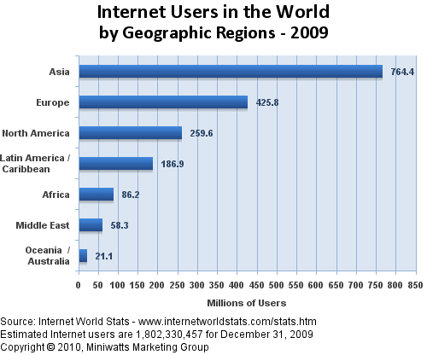

Slide 19
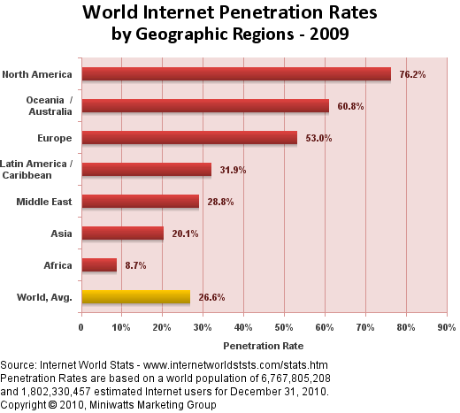

Slide 20
INTERconnecting NETworks
A Network is a series of computers that are connected together to share information and resources.
The Internet is a huge global network made up of millions of smaller networks that are all connected together.

Slide 21
Evolution of the Internet
A brief history of the Internet written by the people who created it:
http://www.isoc.org/internet/history/brief.shtml
Hobbes Internet Timeline:
http://www.zakon.org/robert/internet/timeline/
This is your weekly reading: There will be assessment questions that relate to this content.

Slide 22
What the Internet Offers
Newsgroups
Search Engines
Email and mailing or list servers
Real-time chat
Blogs/Discussion Groups
Podcasts
World Wide Web
Now with Web 2.0 the user has more control – you can create your own software, blogs, websites, social communities

Slide 23
Network Overview

Slide 24
INTERconnecting NETworks
As previously stated the Internet is comprised of a vast collection of computers (from anywhere in the world) that can store information and can also send the information out.
The communication protocol that allowed all this to happen is the Transmission Control Protocol/ Internet Protocol (TCP/IP) Proposed by Vinton Cerf and Robert Kahn.
The internet is also known as a packet switched network.
Notes:
TCP/IP allows computers on the Internet to communicate as if they were directly connected

Slide 25
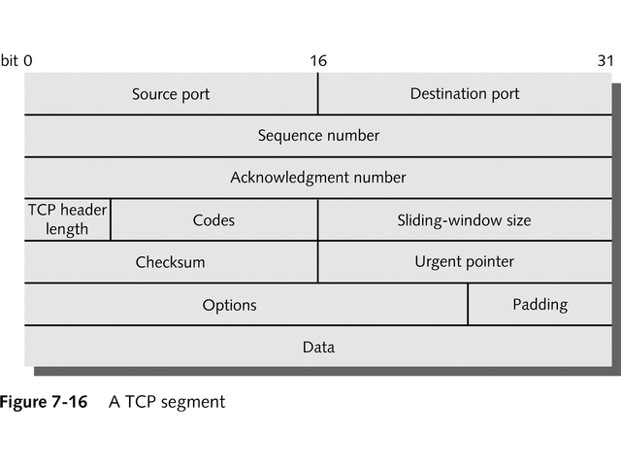
Transmission Control Protocol (TCP)
Tamara Dean 2003, Guide to Telecommunication Technology, 1st edn, Thomson, Boston.

Slide 26
Transmission Control Protocol (TCP)
Provides reliable delivery of data by :
Connection-oriented – a transmission connection is established between source and destination before any data starts being sent.
Reliable - It provides error-checking and retransmission notification.
Flow control – involving the rate of data being sent and received.
Sequencing information – to enable large messages to be split into smaller segments.

Slide 27
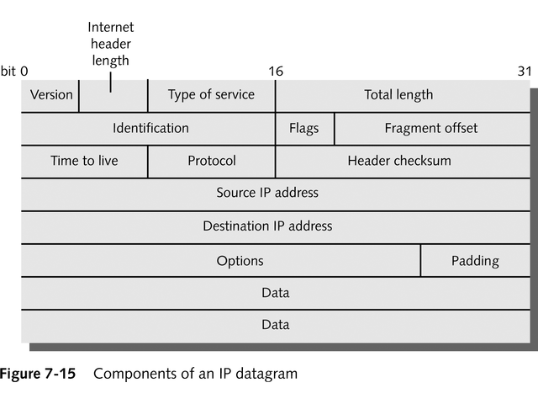
Internet Protocol (IP)
Tamara Dean 2003, Guide to Telecommunication Technology, 1st edn, Thomson, Boston.

Slide 28
Internet Protocol (IP)
It provides information about how and where data should be delivered enabling it to travel through many Networks (over the Internetwork/Internet).
Uses Datagrams (or Packet) – which contain the message payload and network information.
The IP header acts as an envelope for the segment and encapsulates it with information necessary for routers to transfer data between networks or subnets.
IP is an unreliable, connectionless protocol, which means that it does not guarantee delivery of data – its main job is to route data along the best path.

Slide 29
Other Internet & Web protocols
Simple Mail Transfer Protocol (SMTP) is an agreed upon format used by most e-mail software.
Without this standard protocol, there would be many incompatible e-mail formats, and you would be able to exchange e-mail only with people who were using the same e-mail software.
Another common Internet Protocol is File Transfer Protocol (FTP), which is used to copy files from one computer to another.

Slide 30
About Networks
Local area network (LAN) - a network of nodes (computers and other devices) that is confined to a relatively small space, such as one building or even one office. Usually under local administration control and owned by the organization.
Connectivity device e.g. Hub, router, switch - when multiple networks or multiple parts of one network need to communicate with each other, this device is used to connection network segments enabling the exchange of data.

Slide 31
About Networks
Metropolitan area network (MAN) - a network that connects nodes and network segments in multiple buildings in a region. Usually connecting sub-networks (subnets) or small networks together to form a larger network.
Wide area network (WAN) - a network that connects two or more geographically distinct LANs into one larger network enabling the nodes on all networks to communicate with each other.
The Internet is a global WAN

Slide 32
Network Common components
Common components of a network include:
Server computers
Client workstation computers
Shared devices such as printers
Networking devices (hub) and the media that connect them

Slide 33
Network Overview
Clients are the computers used by individuals, such as a PC on a desk
The Server receives requests from client computers for resources such as files.
Computers used as servers are usually kept in a protected, secure environment and only accessed by administrators.

Slide 34
About Networks
A port allows you to plug in a cable to connect a peripheral device, such as monitor, printer or modem.
Port numbers identify particular services on an Internet host computer
port 25 used for SMTP (mail transfers)
port 23 used for TELNET (remote host connection)
port 80 used for HTTP (web transfers)
Notes:
Other ports (1024 - 65535) can be used by user-developed programs:
port 8080, 3132 used for proxy; ie http://proxy.bond.edu.au:8080

Slide 35
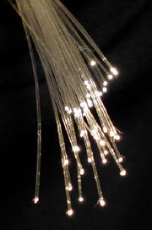
Network Overview
Computer connections can be:
twisted pair cable or ISDN (like telephone)
network cable (CAT standard)
optical fibre cable (much greater capacity)
wireless links
microwave links (uses satellite dish or transceiver)
power cables, human body*, other exotic methods

Slide 36
Global Networks
Level 2: National Backbone Providers (Optic Fibre at 2400Mbps)
Level 3: Regional Internet Providers (100Mbps)
Level 4: Local Internet Service Providers (56Kbps- 10Mbps)
Level 5: Business and Consumers (56Kbps-10Mbps)
History of the Internet in Australia
http://www.rogerclarke.com/II/OzI04.html

Slide 37
Global Networks
The large transmission lines are called the backbone.
The packet will jump off the backbone when it reaches a network that can link it to its final destination.
Notes:
Backbone think road2ways and main highways. Backbone of a body.

Slide 38
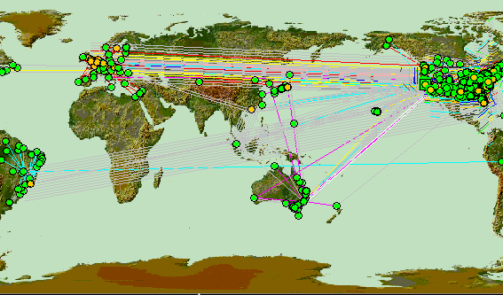
Backbone
Access points or junctions to the Internet backbone in major cities are called Network Access Points (NAPs)
http://www.caida.org/tools/visualization/mapnet/Backbones

Slide 39
ISP
To connect to the Internet you need an Internet Service Provider
A company that offers hours on the Internet each month usually for a set fee.(More about ISP later)
You cannot access the Internet without an Internet Service Provider

Slide 40
Standards and Coordination
No single person or group runs the entire Internet.
Each separate network is managed individually.
There are a number of groups that develop standards and guidelines and are the driving force in the growth and evolution of the Internet

Slide 41
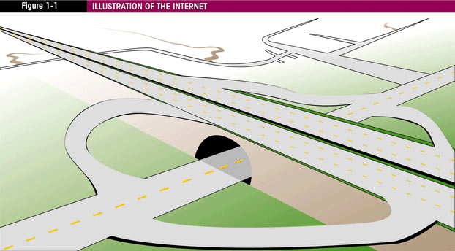
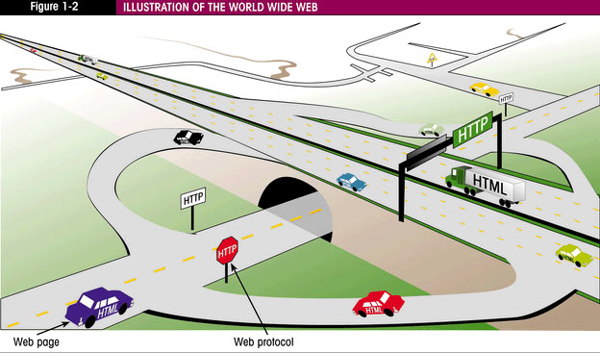
Internet and the Web
The Web is part of the Internet with its own protocol and its own document structure called Hypertext Markup Language (HTML).
HTML provides instructions on how to format the Web pages for display.
Notes:
The web page vehicles follow the http rules of the road to travel the internet highways.
Other vehicles follow other rules to share the internet.

Slide 42
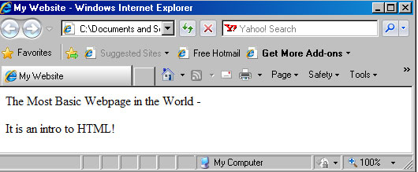
HTML
<!DOCTYPE html PUBLIC "-//W3C//DTD XHTML 1.0 Transitional//EN" "http://www.w3.org/TR/xhtml1/DTD/xhtml1-transitional.dtd"> <html xmlns="http://www.w3.org/1999/xhtml"> <head> <meta http-equiv="Content-Type" content="text/html; charset=utf-8" /> <title>My Website</title> </head> <body> The Most Basic Webpage in the World - It is an intro to HTML! </body> </html>

Slide 43
The Web Wide Web
Hypertext Transfer Protocol (HTTP) controls the transfer of HTML web pages over the internet.
Notes:
The web page vehicles follow the http rules of the road to travel the internet highways.
Other vehicles follow other rules to share the internet.

Slide 44
Internet, Intranets & Extranets
The Internet is globally accessible, therefore when an organisation needs the communication capabilities but does not want information accessible to everyone, they can create either an intranet or extranet.
An Intranet is a private network contained within an organisation or business. When connected to the outside (Internet), usually a gateway or firewall protects the intranet from unauthorised access.

Slide 45
Internet, Intranets and Extranets
An Extranet is a private network that securely shares part of an organisations information with external partners such as suppliers, vendors, and customers.
Can be used to share information or data with business partners or other organisations.
Digital certificates, encryption messages and virtual private networks (VPNs) are some technologies used to provide privacy and security for an extranet.
Notes:
A digital certificate (sometimes called a digital ID) is the electronic counterpart to a driver license, passport or membership card. It is specially formatted block of data that serves as a form of personal identification that can be verified electronically. ...
A good example of a company that needs a remote-access VPN would be a large firm with hundreds of sales people in the field. Remote-access VPNs permit secure, encrypted connections between a company's private network and remote users through a third-party service provider.

Slide 46
Development of the WWW

Slide 47
The Evolution of the WWW
Originally the Internet was text based and information on the computers was not easy to obtain.
While working at CERN, a research based facility in Switzerland, Tim Berners Lee envisioned a means of communication for scientists where they could easily ‘hyperlink’ to another research paper or document and immediately view it.

Slide 48
The Evolution of the WWW
This version of the World Wide Web used Hypertext Transfer Protocol (HTTP) to communicate between the client computer and the Web server and Hypertext Markup Language (HTML) to format the documents, but was still text based.
The first webpage: http://www.w3.org/History/19921103-hypertext/hypertext/WWW/TheProject.html

Slide 49
The Evolution of the WWW
In 1993 the first graphics based Web browser, Mosaic, became available. Individuals from the group that created Mosaic later went onto create another well known Web browser, Netscape Navigator.
The combination of commercial use, HTTP, and Graphical User Interfaces (GUI) made the information on the Internet much easier to access.

Slide 50
Standards and Coordination
One of the most important groups is the Internet Society (ISOC) a private, non profit group which provides leadership in issues related to the future of the Internet.
It is also the organisational home for groups responsible for Internet infrastructure standards: http://www.isoc.org

Slide 51
Standards and Coordination
The Internet Corporation for Assigned Names and Numbers (ICANN) http://www.icann.org is a nonprofit organization established in 1998 to co-ordinate the assignment of Internet domain names, IP address numbers, human friendly domain names – e.g. .com, .org, .net etc.
Notes:
.

Slide 52
Standards and WWW
The World Wide Web Consortium (W3C) www.w3.org develops standards for the evolution of the most well known area of the Internet – the WWW.
W3C is an industry consortium.
Four major areas the W3C address are:
Web architecture
User Interface
Technology and Society
Web Accessibility
W3C produces specifications called recommendations.

Slide 53
Standards and WWW
The good news is that there is a convergence toward the W3C Recommendations in new versions of major browsers.
There are even groups such as the The Web Standards Project, http://webstandards.org whose mission is to promote W3C Recommendations (also known as Web Standards) not only to creators of browsers but also to Web developers and designers

Slide 54
Accessibility and the Web
The Web Accessibility Initiative (WAI) http://w3c.org/WAI/ is a major area of work by the W3C.
According to Tim Berners Lee “The power of the Web is in its universality. Access by everyone regardless of disability is an essential aspect”
See the WAI’s Web Content Accessibility Guidelines ( WCAG) at http://www.w3c.org/WAI/WCAG20/quickref/

Slide 55
Impact and Future Trends
New communication medium and careers:
Internet Service Providers
Web Content Publishers and designers
Electronic commerce
Business opportunities for anyone
World Wide customer base
Communication options for the disabled
Multimedia developers
Game developers
Education and training
Wider research options

Slide 56
Impact and Future Trends
More use of embedded chips in clothing and humans
Computer operated everyday items
Virtual worlds
Serious Games
Augmented Reality
More aids for the disabled
Thinking computers?
Notes:
Animals already common use of chips

Slide 57
Vocabulary
Internet
Network
WAN
LAN
Client /Server
Protocol
Simple Mail Transfer
File Transfer Protocol
Internet Protocol (IP Address)
Internet Service Provider
Port
Port Numbers
Backbone
Packet

Slide 58
Summary
Course introduction
Why are we studying this course?
What is expected in this course?
Networking basics
TCP/IP
Network components
Network types
World Wide Web
WWW vs Internet
Standards
Future of the internet and WWW

